Slide 1
Catheter
Placement Project
ADS2002
THU Group 5
Sneha
Charis
Sanugi
Ashlyn
Edmund
Shekinah

Slide 2
Background Info
Using a large labeled dataset of chest radiographs to create our models and analyse the data
Detect the presence and position of various medical lines and tubes in chest radiographs
Mispositioned tubes can lead to severe complications.
Aims to improve patient safety and reduce the likelihood of human error in high-stress hospital environments.

Slide 3
The goal
The aim of this project is to develop deep learning models that accurately classify medical images to detect the presence and proper placement of various catheter tubes

Slide 4
Data Pre-processing

Slide 5
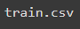
First Look at the Data
The dataset consists of 40,000 labeled chest X-rays, each indicating the correct or incorrect placement of various medical tubes, used to train our model for accurate detection.
Two main csv files for analysis
Using the shape attribute of a dataset
No missing values were found

Slide 6
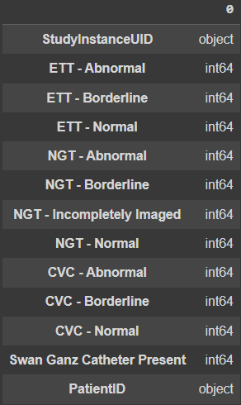
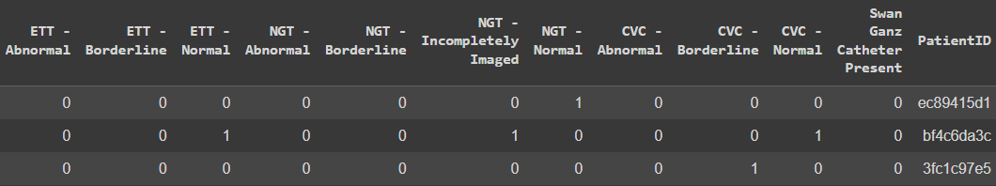
Training set
Comprised of 13 columns: two IDs and 11 labels marked with binary values All unique Image IDs and roughly 3200 unique patient IDs
Will be used for validation

Slide 7
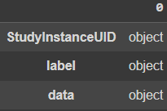
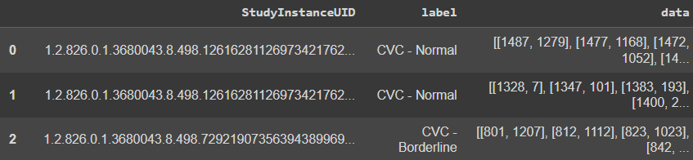
Annotated subset of training set
Comprised of three columns : image ID, label and annotation
Will be used to train the model

Slide 8
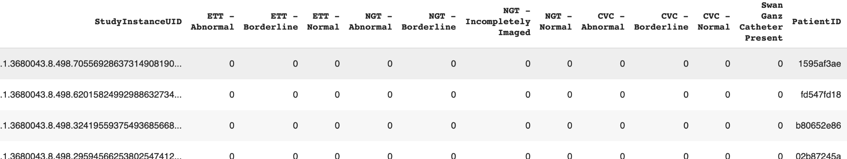
Cleaning the data
Removed rows with all zeros, rows with NGT incompletely imaged, Swan Ganz catheter rows
Rows representing images with no tubes

Slide 9
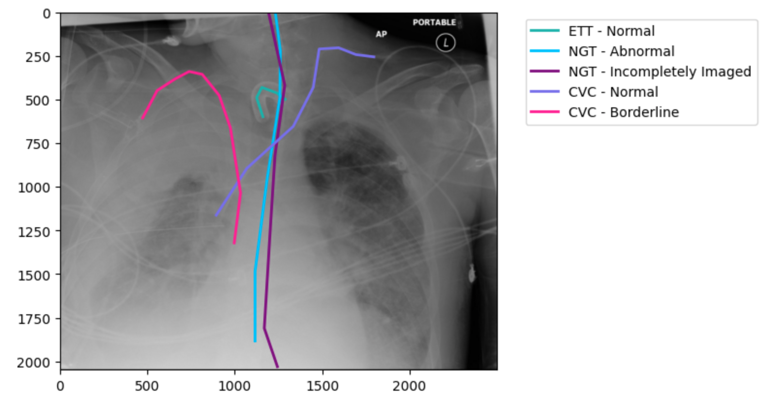
Overlaying Data Points
X-ray image overlaid with coloured lines representing catheters, using annotations

Slide 10
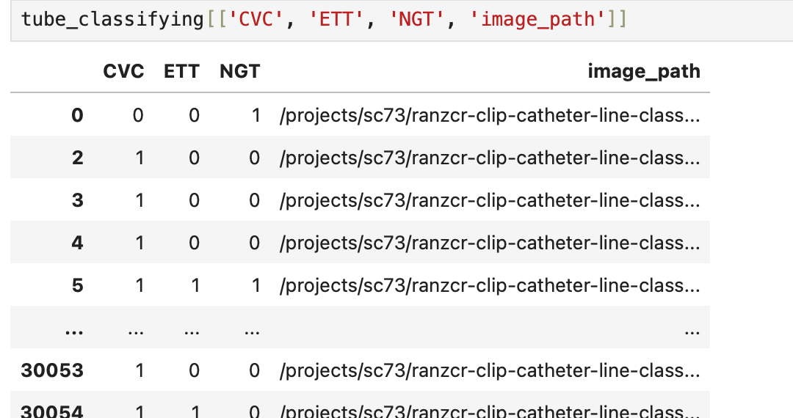
Dataset For Classifying Types of Tubes Present

Slide 11
Exploratory Data Analysis

Slide 12
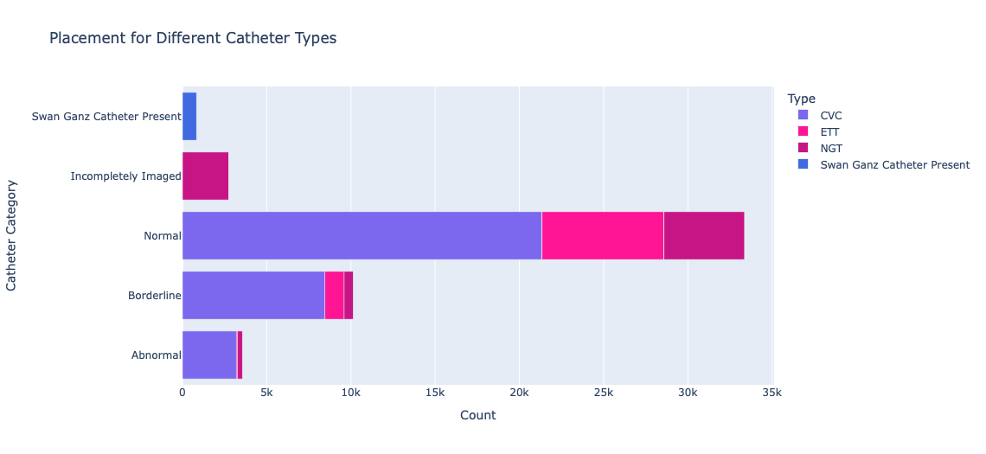
Placement for Different Catheter Types

Slide 13
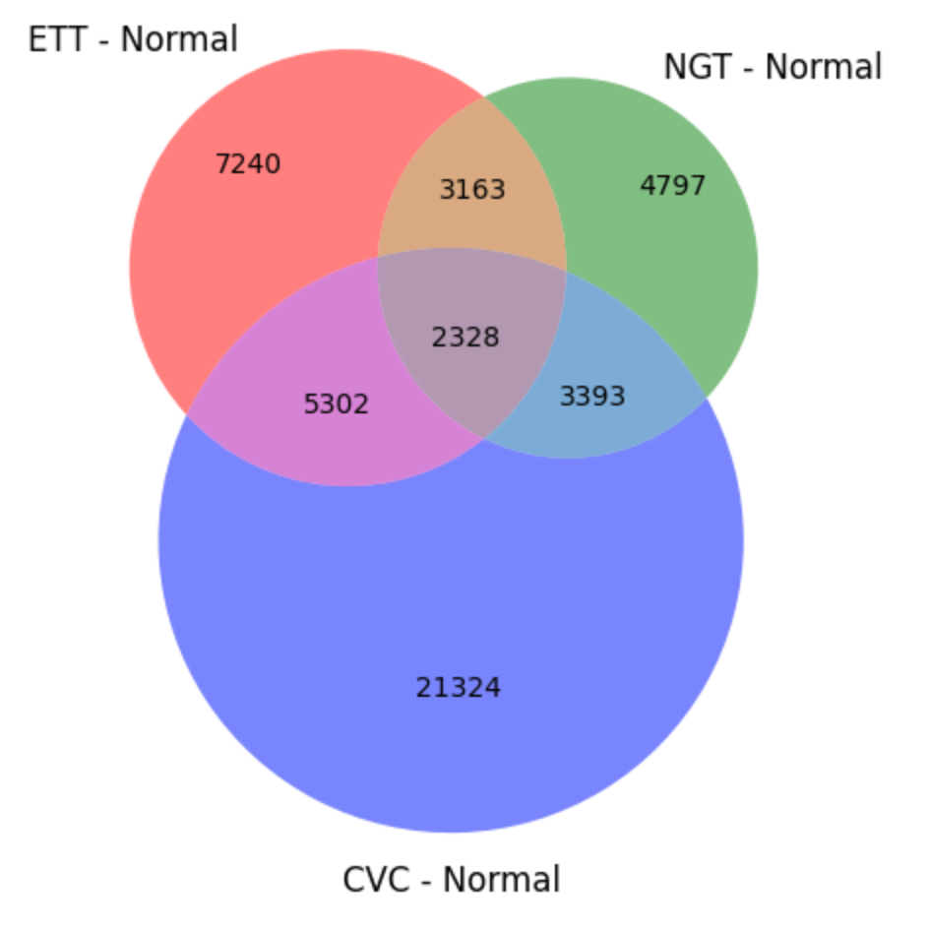
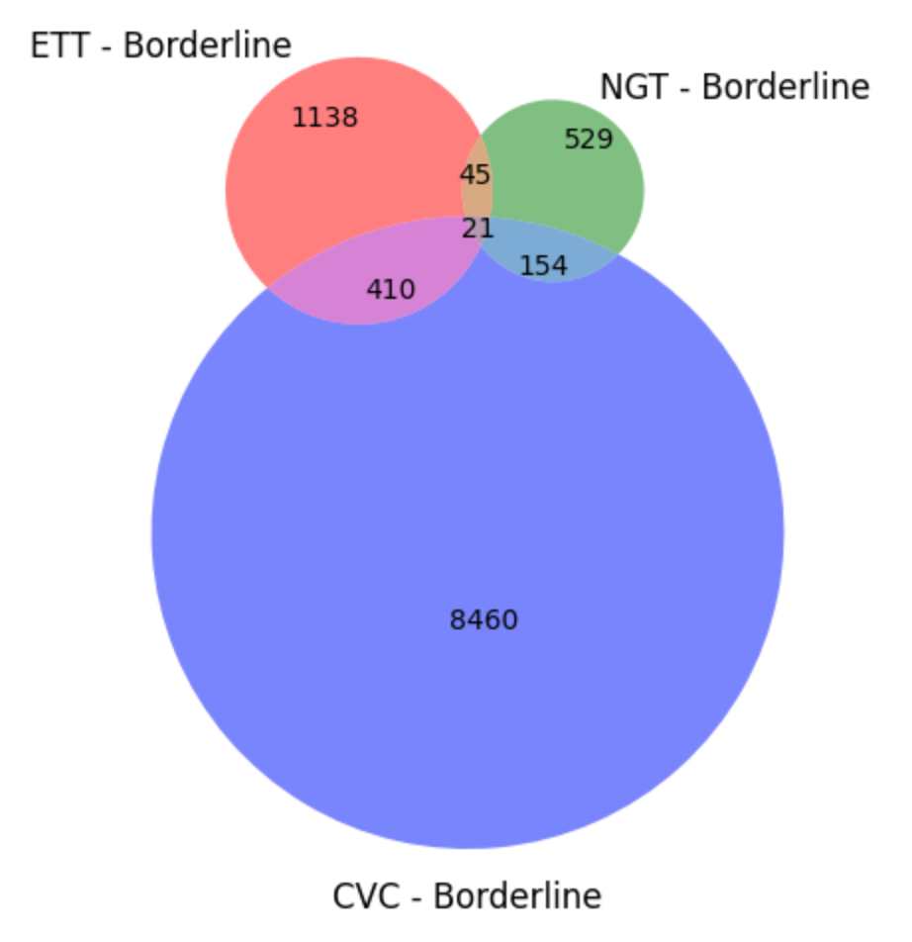
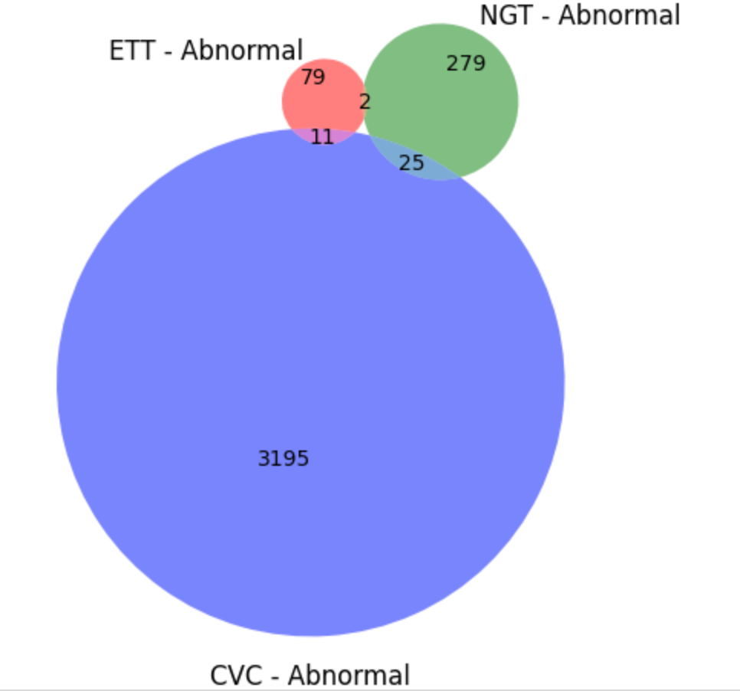
Distribution of Catheter Types by Placement

Slide 14
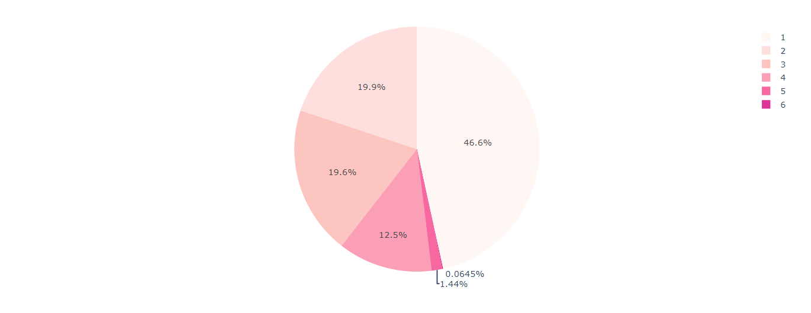
Number of tubes frequency

Slide 15
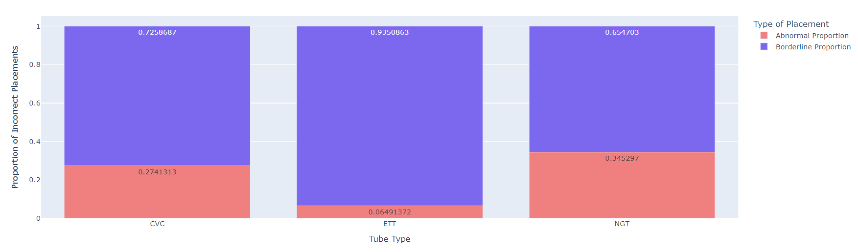
Proportion of Abnormal and Borderline Placements by tube type

Slide 16
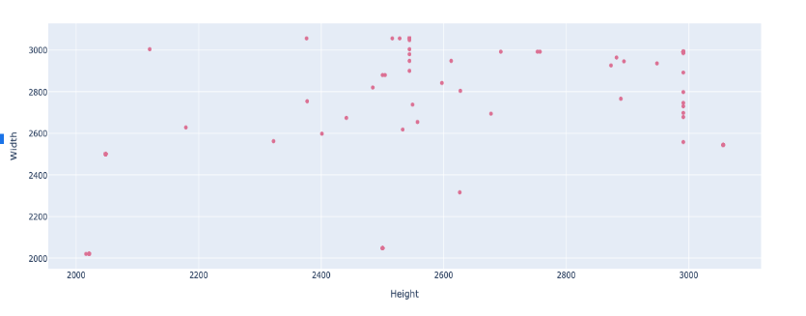
Sample of Image Dimensions

Slide 17
Modelling

Slide 18
Transfer Learning
What is it?
A technique where a pre-trained model (previously trained on a large dataset) is adapted for a new task.
Allows us to use the features the model has already learned, so we don't have to begin training from scratch.
Why are we using it?
Using a smaller dataset
Models trained on a variety of data can often generalise better to new and unseen data
Pre-trained models can utilise sophisticated architecture that is often too complex to train from scratch

Slide 19
Transfer Learning
The process:
Take layers from previously trained model and freeze them so their weights aren’t updated
Add new trainable layers on top of the frozen layers and train the new layers on your dataset with a relatively large learning rate
Unfreeze a small part of the layers previously frozen and retrain the model with a low learning rate

Slide 20
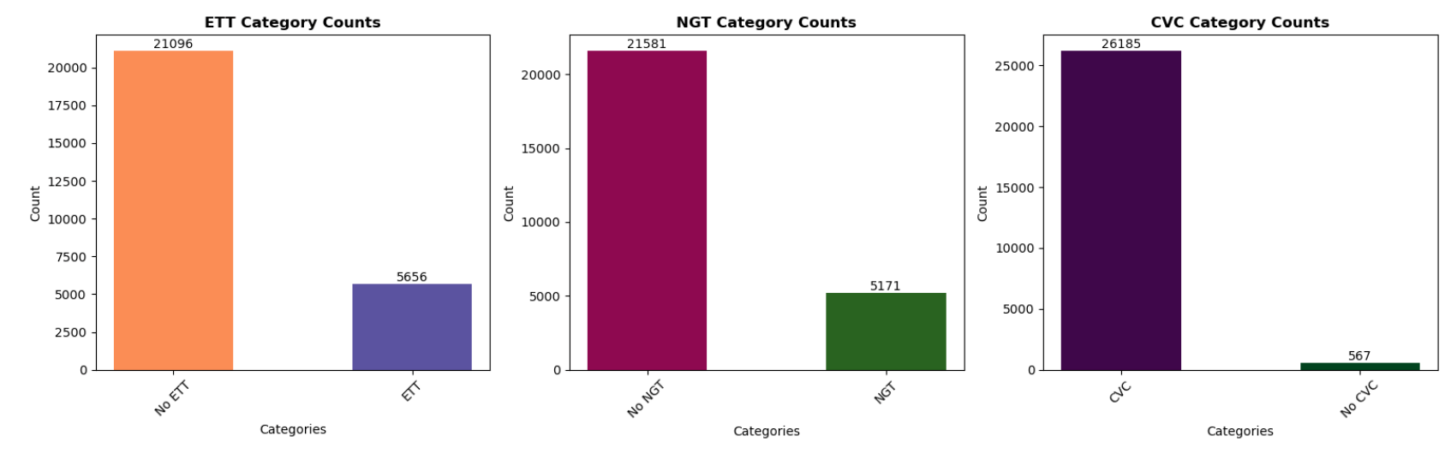
Training Data

Slide 21
EfficientNetB0 CNN Model -
(with annotated images)
Why we used it:
It scales all dimensions of depth/width/resolution using a simple yet highly effective compound coefficient.
Looked into the same competition in Kaggle, competitors with high ranking used this architecture for predicting the types of catheters

Slide 22
EfficientNetB0 CNN Model
Top Layer Design:
Global average pooling
ReLU dense layer
Dropout layer (0.5)
Final sigmoid dense layer
Methods used:
Model checkpointing and Early stopping
Adam optimizer
Binary cross entropy loss function
Data Augmentation - rotation

Slide 23
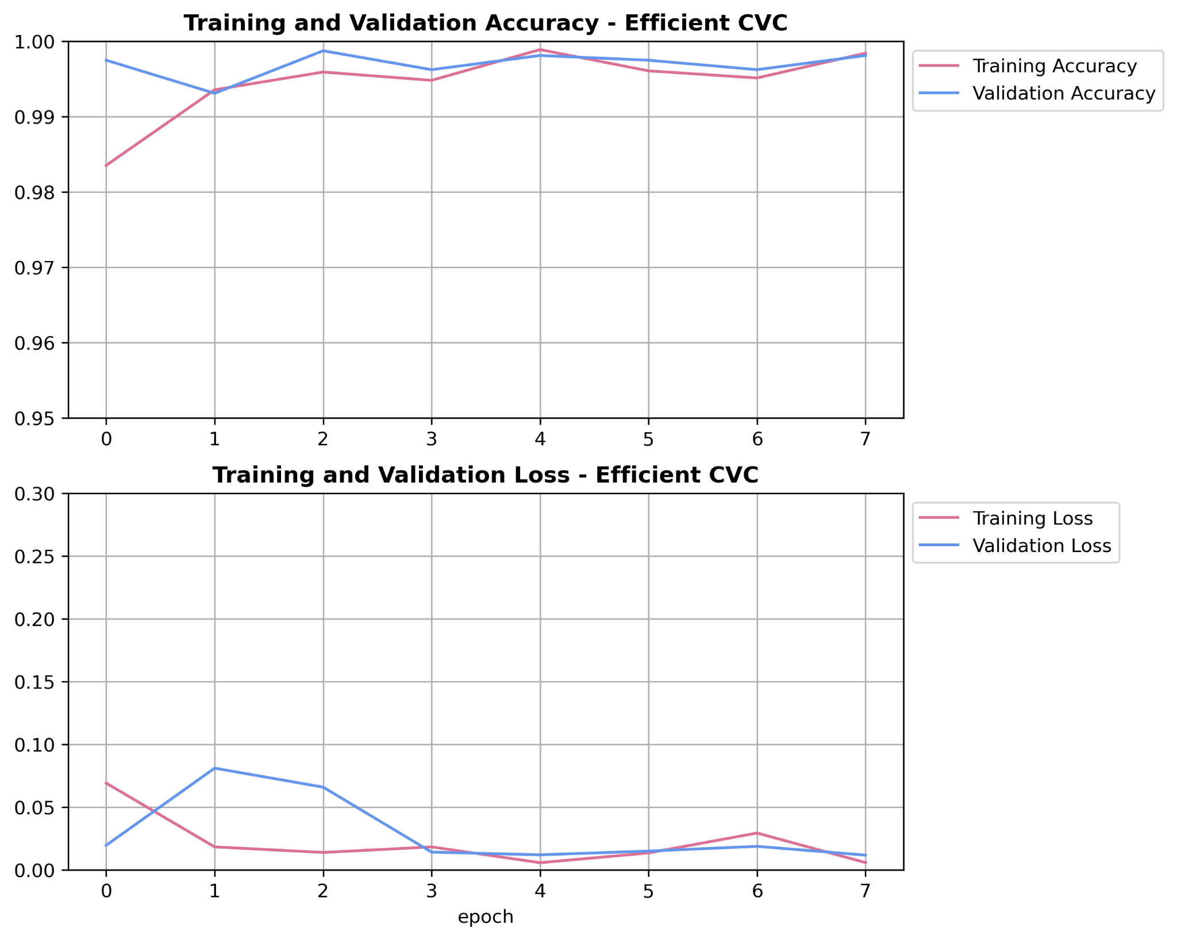
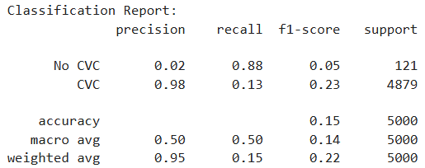
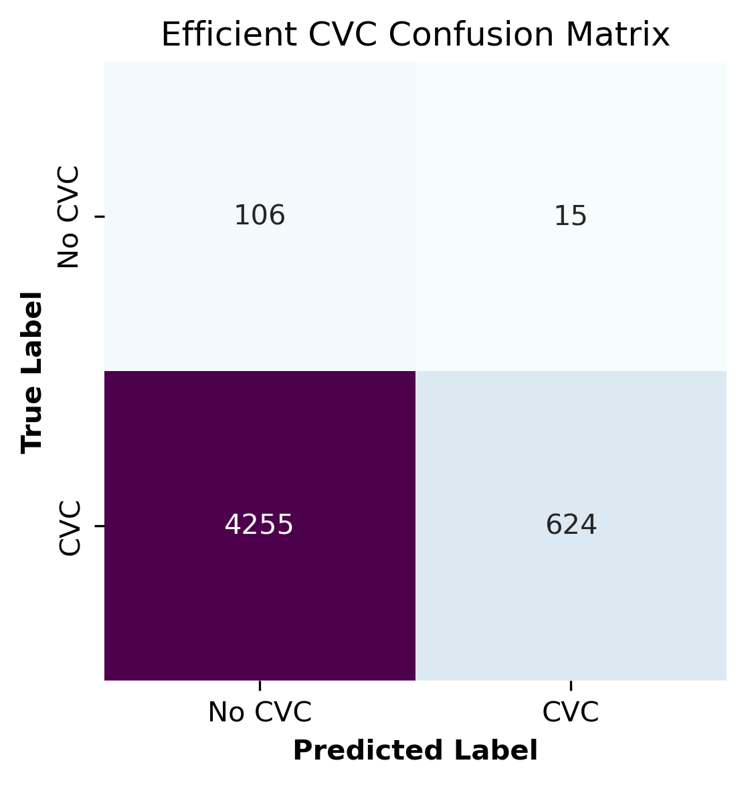
EfficientNetB0 - Classifying CVC Tubes

Slide 24
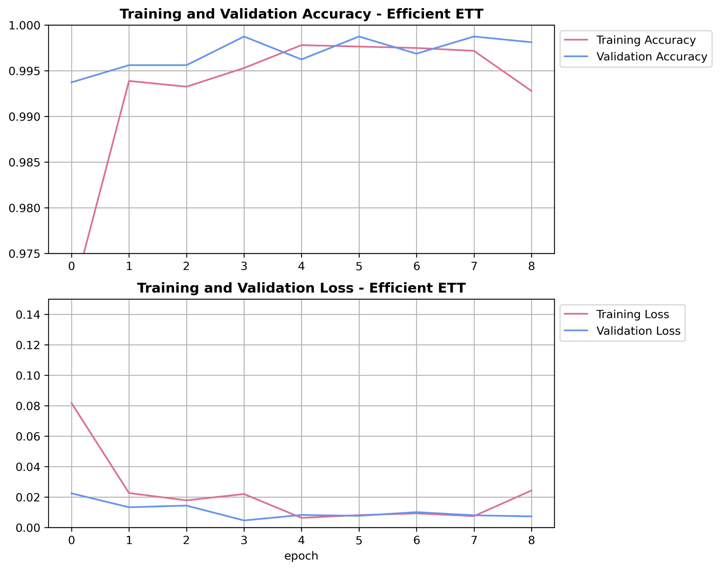
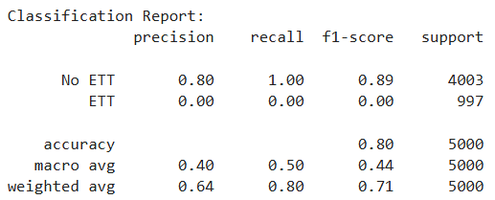
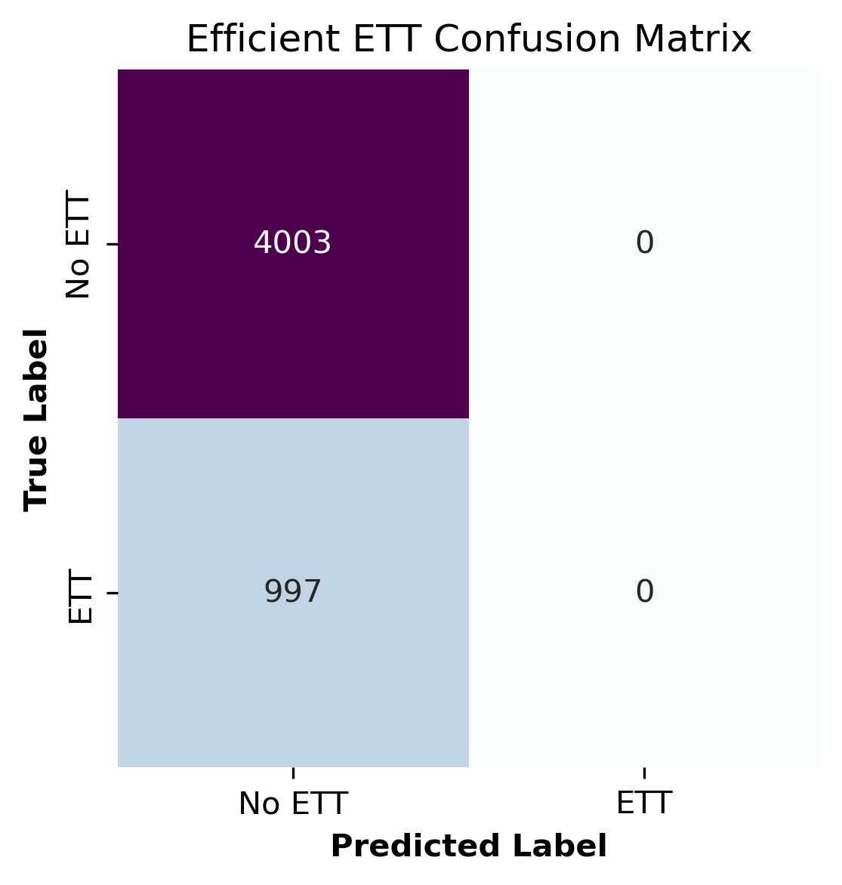
EfficientNetB0 - Classifying ETT Tubes

Slide 25
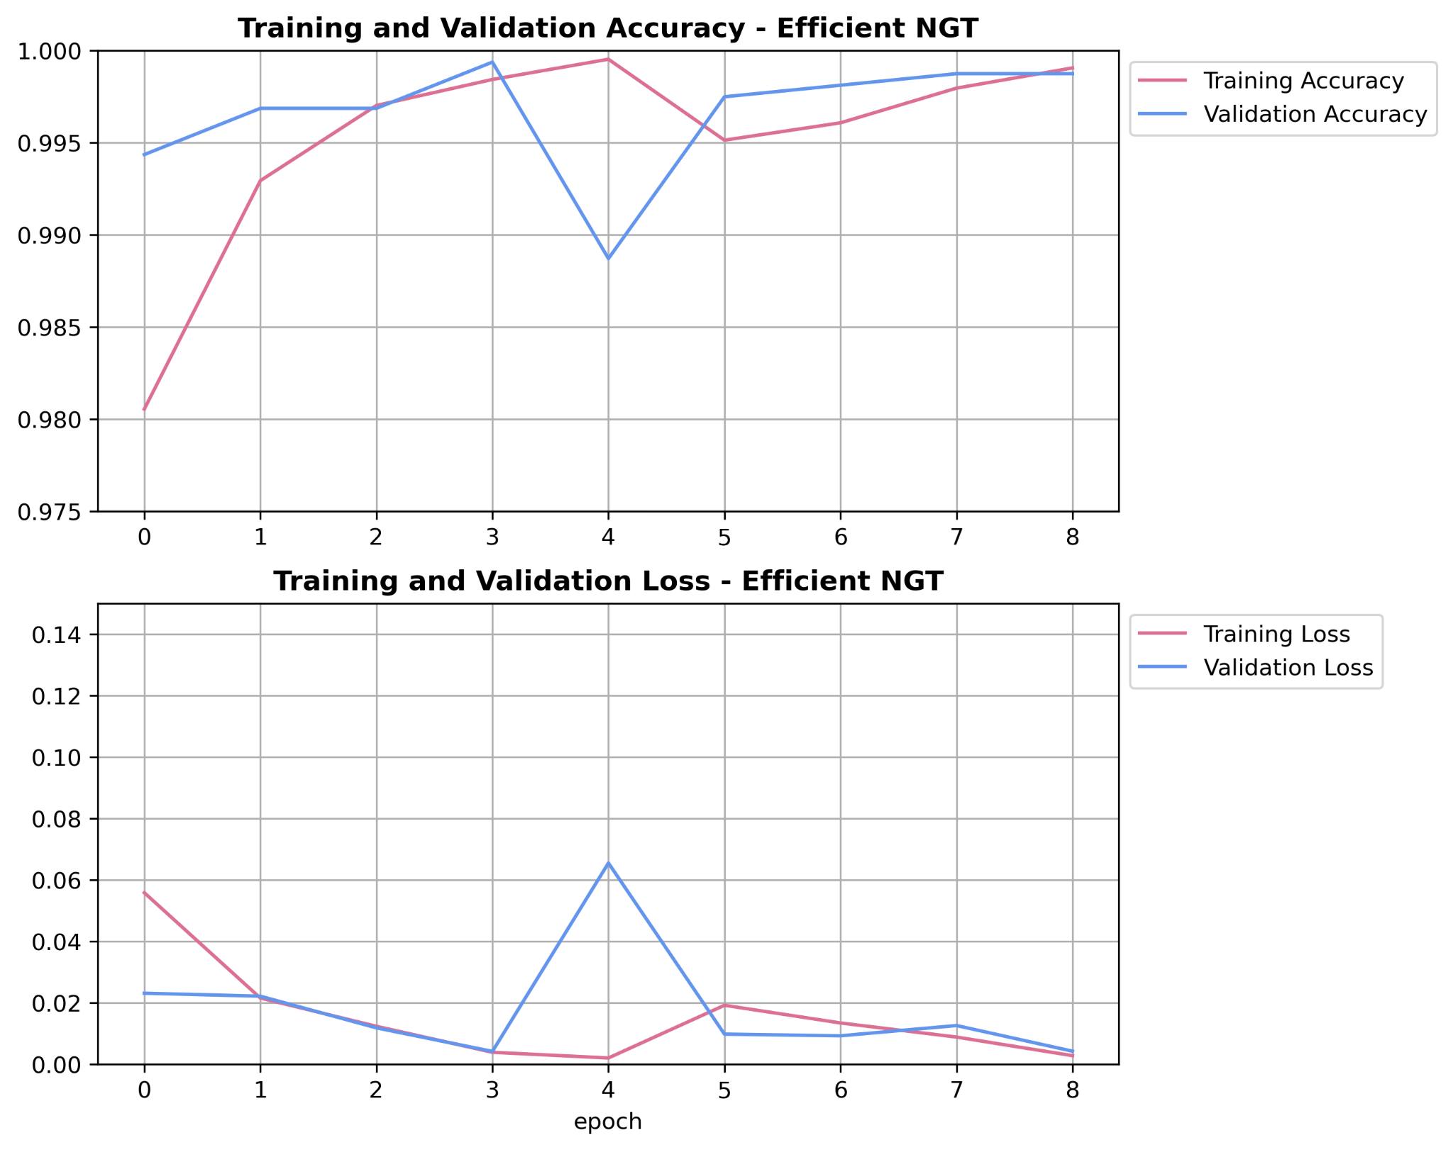
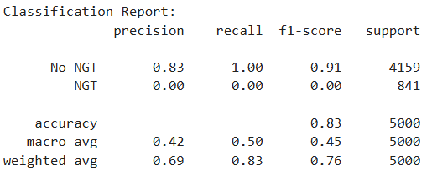

EfficientNetB0 - Classifying NGT Tubes

Slide 26
MobileNetV2 CNN Model
(w/o annotated data)
Why we used it:
A lightweight 53-layer Deep Convolutional Neural Network model with a smaller number of parameters
Lower computational cost, and faster to train
Can be used when computational resource is limited, such as image classification and object detection on mobile devices

Slide 27
MobileNetV2 CNN Model
Top Layer Design:
Global average pooling
ReLU dense layer
Dropout layer (0.5)
Final sigmoid dense layer
Methods used:
Model checkpointing and Early stopping
Adam optimizer
Binary cross entropy loss function
Data Augmentation - rotation

Slide 28
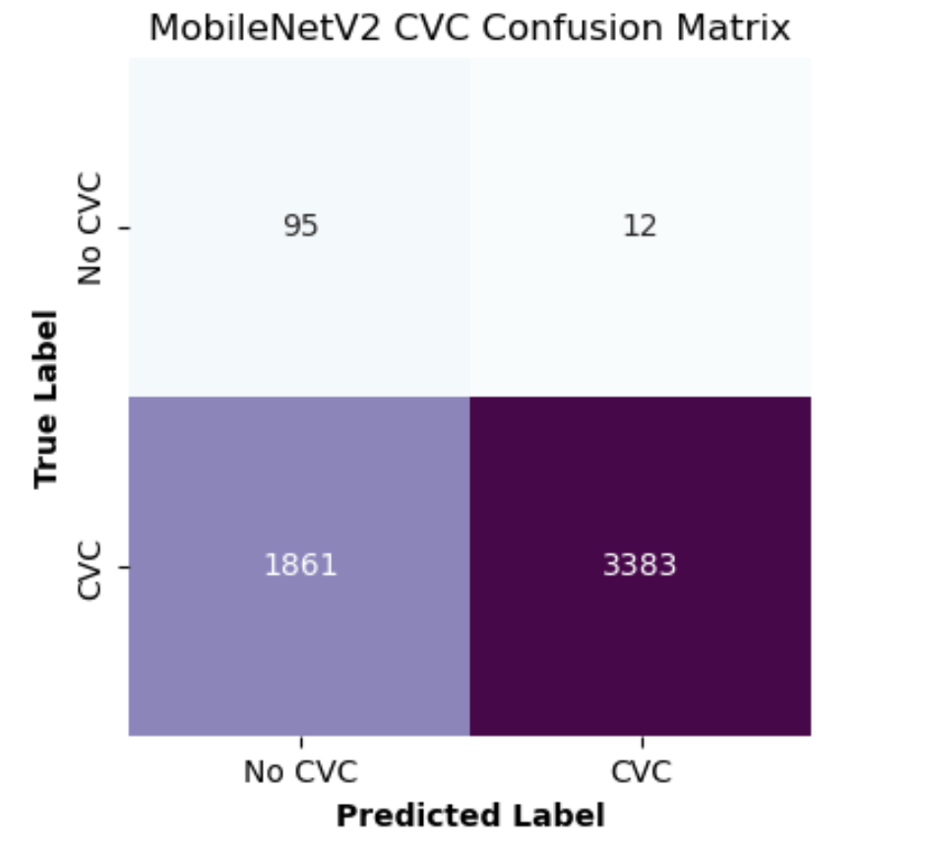
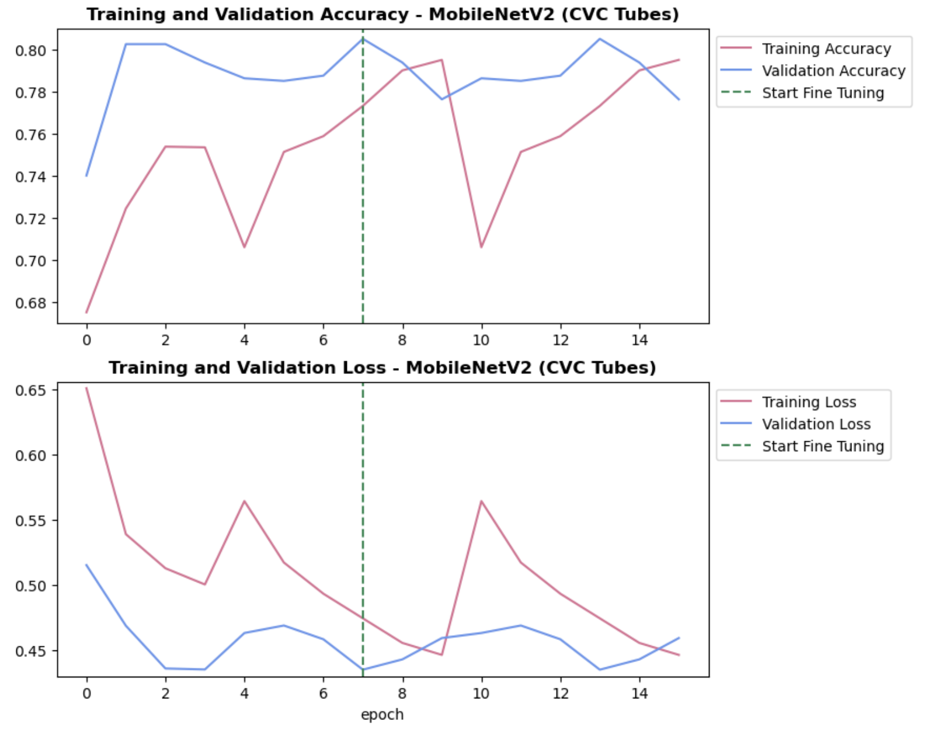
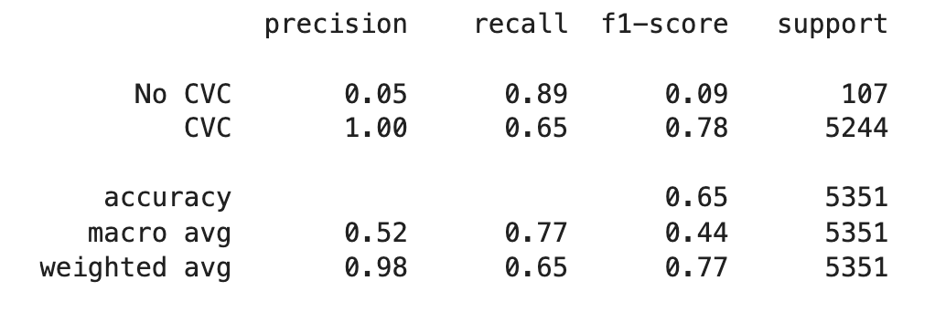
Classifying CVC Tubes

Slide 29
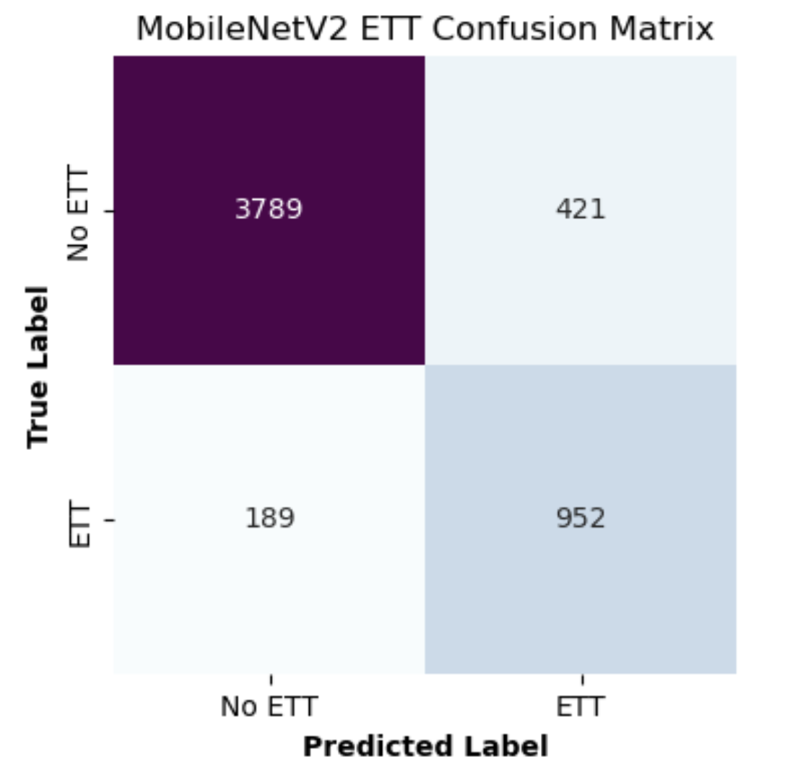
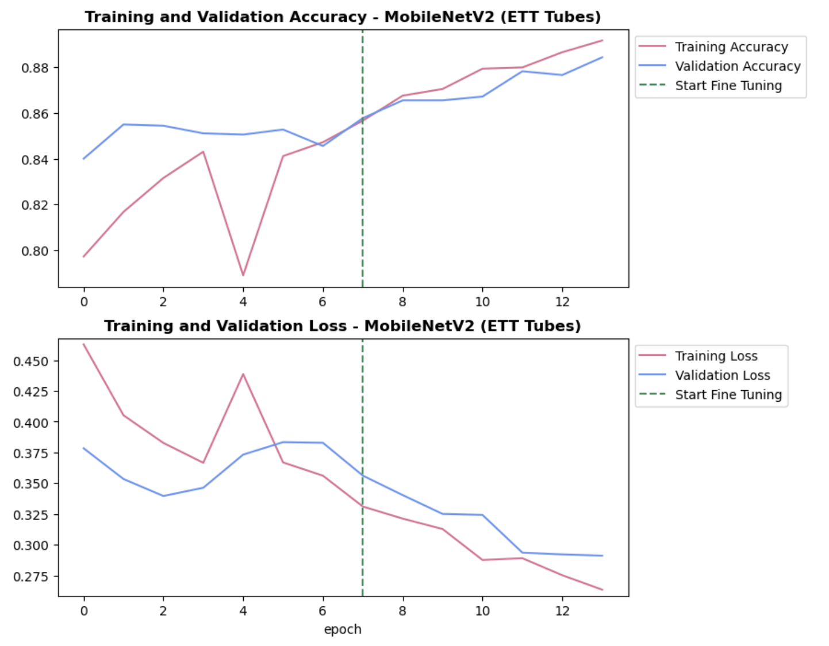
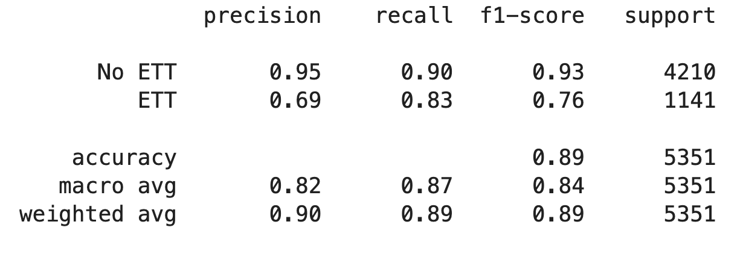
Classifying ETT Tubes

Slide 30
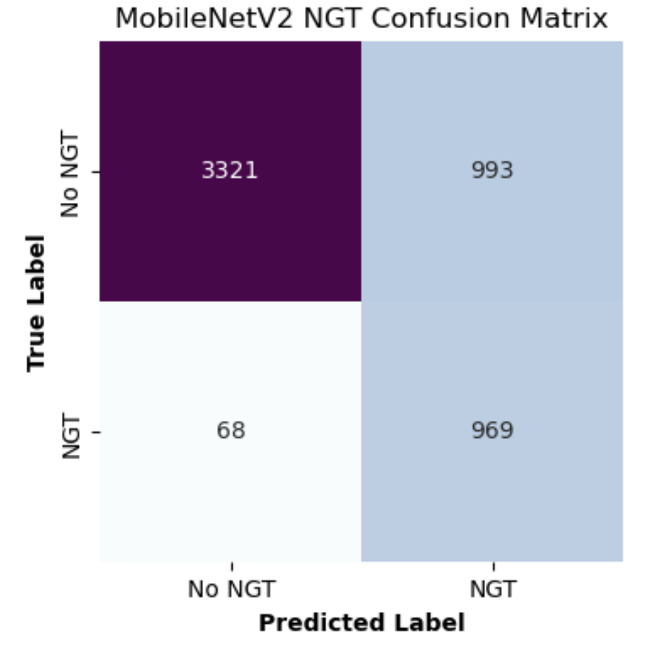
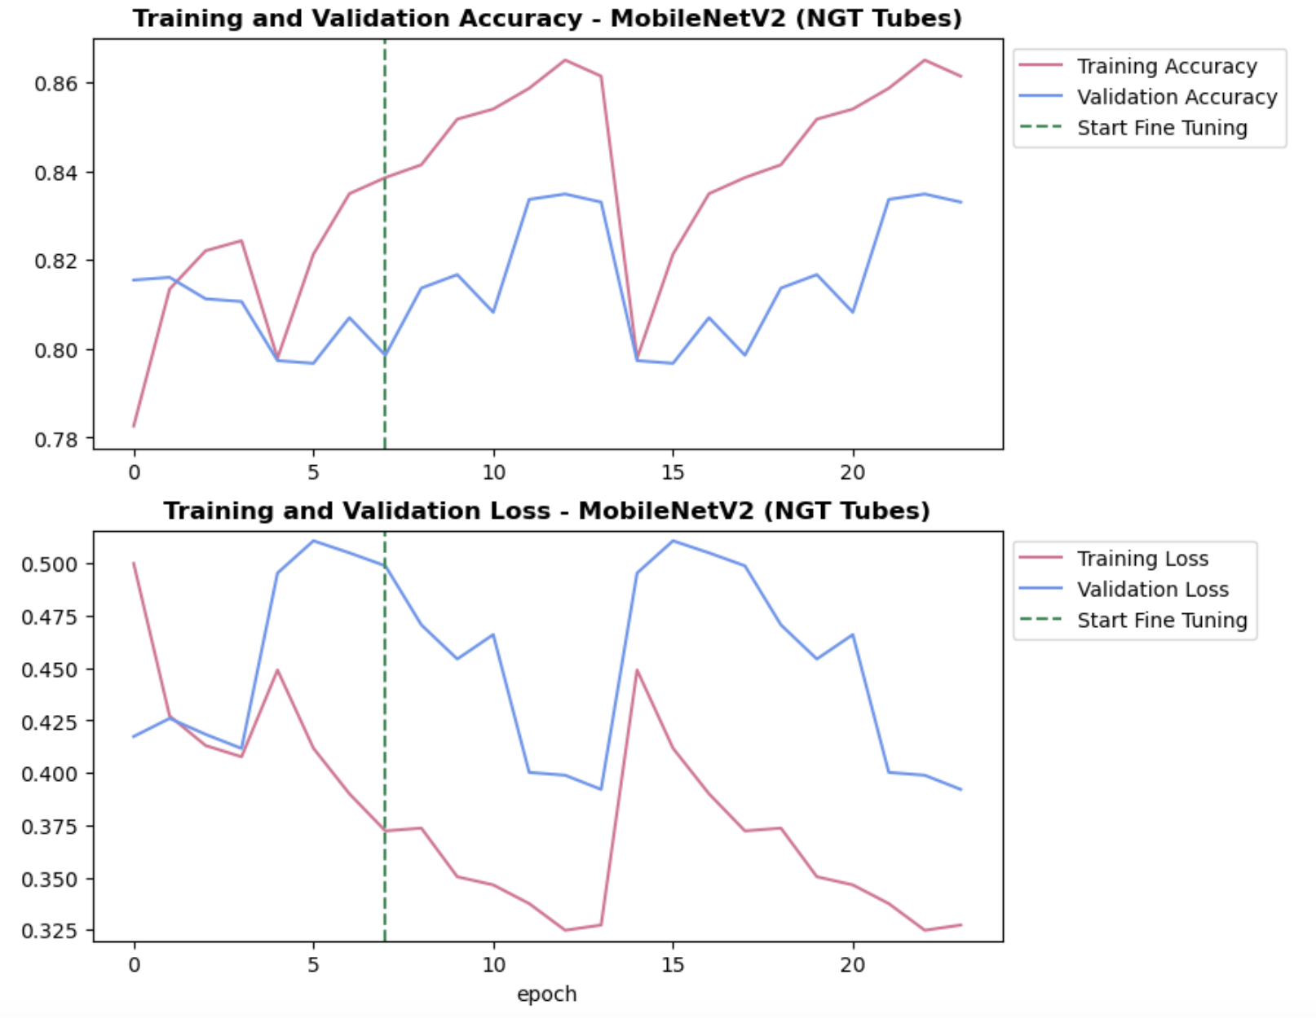
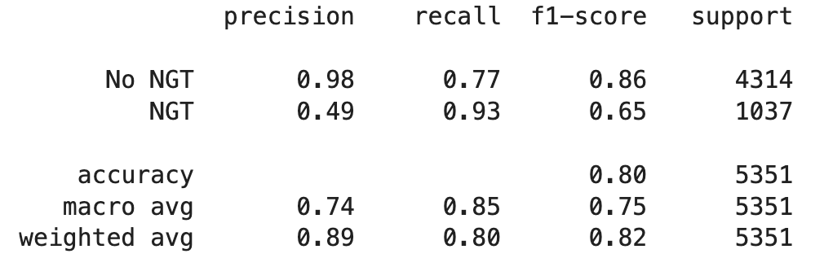
Classifying NGT Tubes

Slide 31
Resnet50 CNN Model
Why we used it:
a Deep Convolutional Neural Network with 50 layers, uses skip connections to address vanishing gradients enabling it to learn complex patterns from the data.
Successful in other medical imaging tasks such as brain tumor classification and detection of pulmonary infections in COVID-19 CT scans.

Slide 32
Resnet50 CNN Model
Top Layer Design:
Global average pooling
ReLU dense layer
Dropout layer (0.5)
Final sigmoid dense layer
Methods used:
Model checkpointing and Early stopping
Adam optimizer
Binary cross entropy loss function
Data Augmentation - rotation

Slide 33
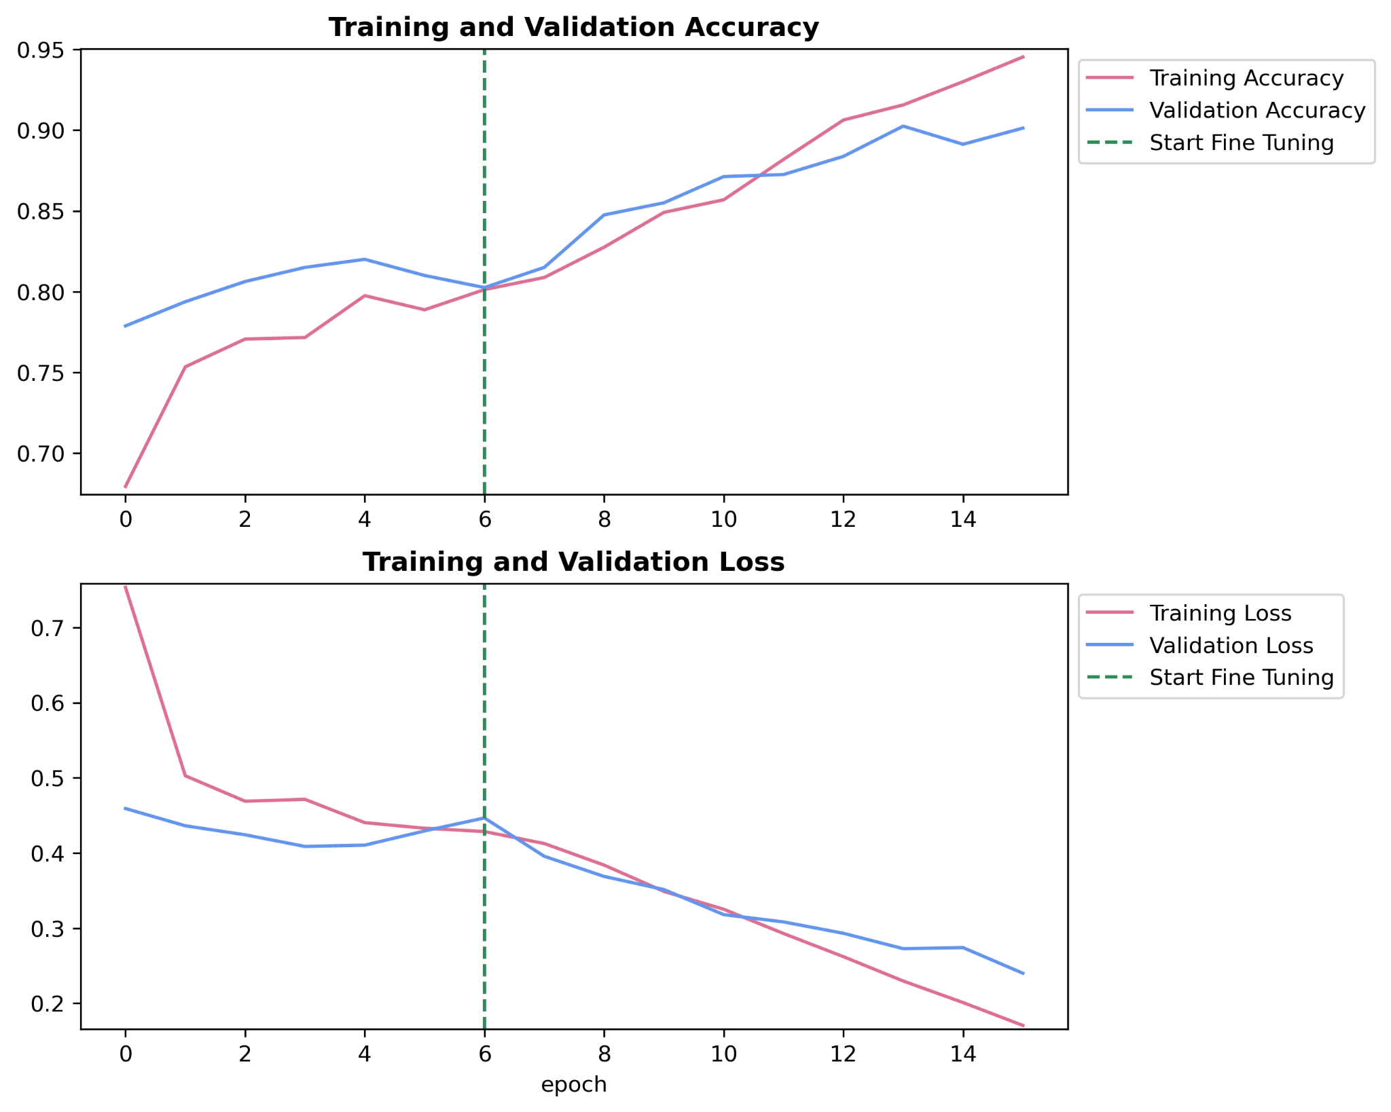
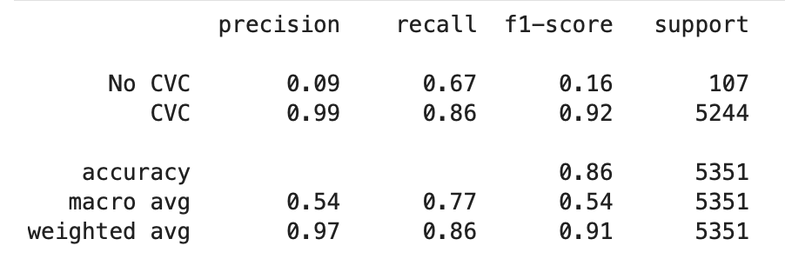
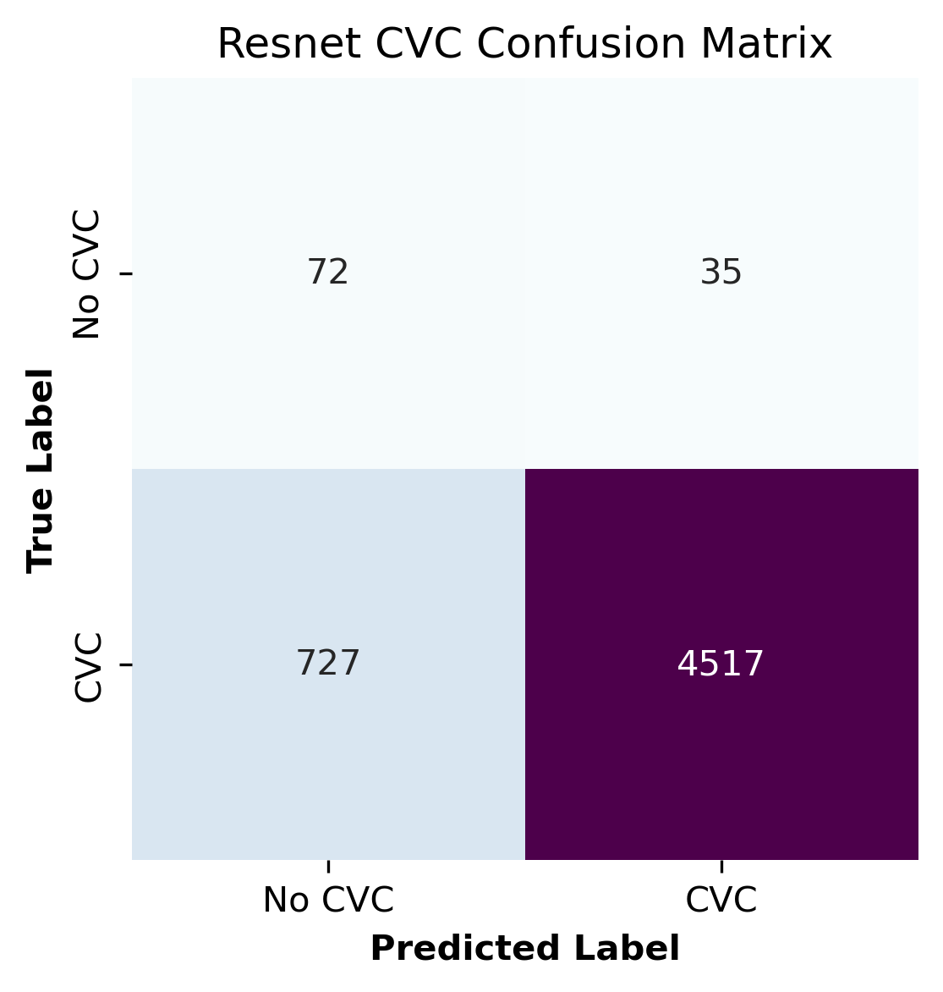
Classifying CVC Tubes

Slide 34
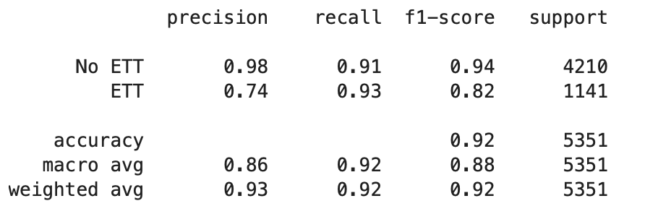
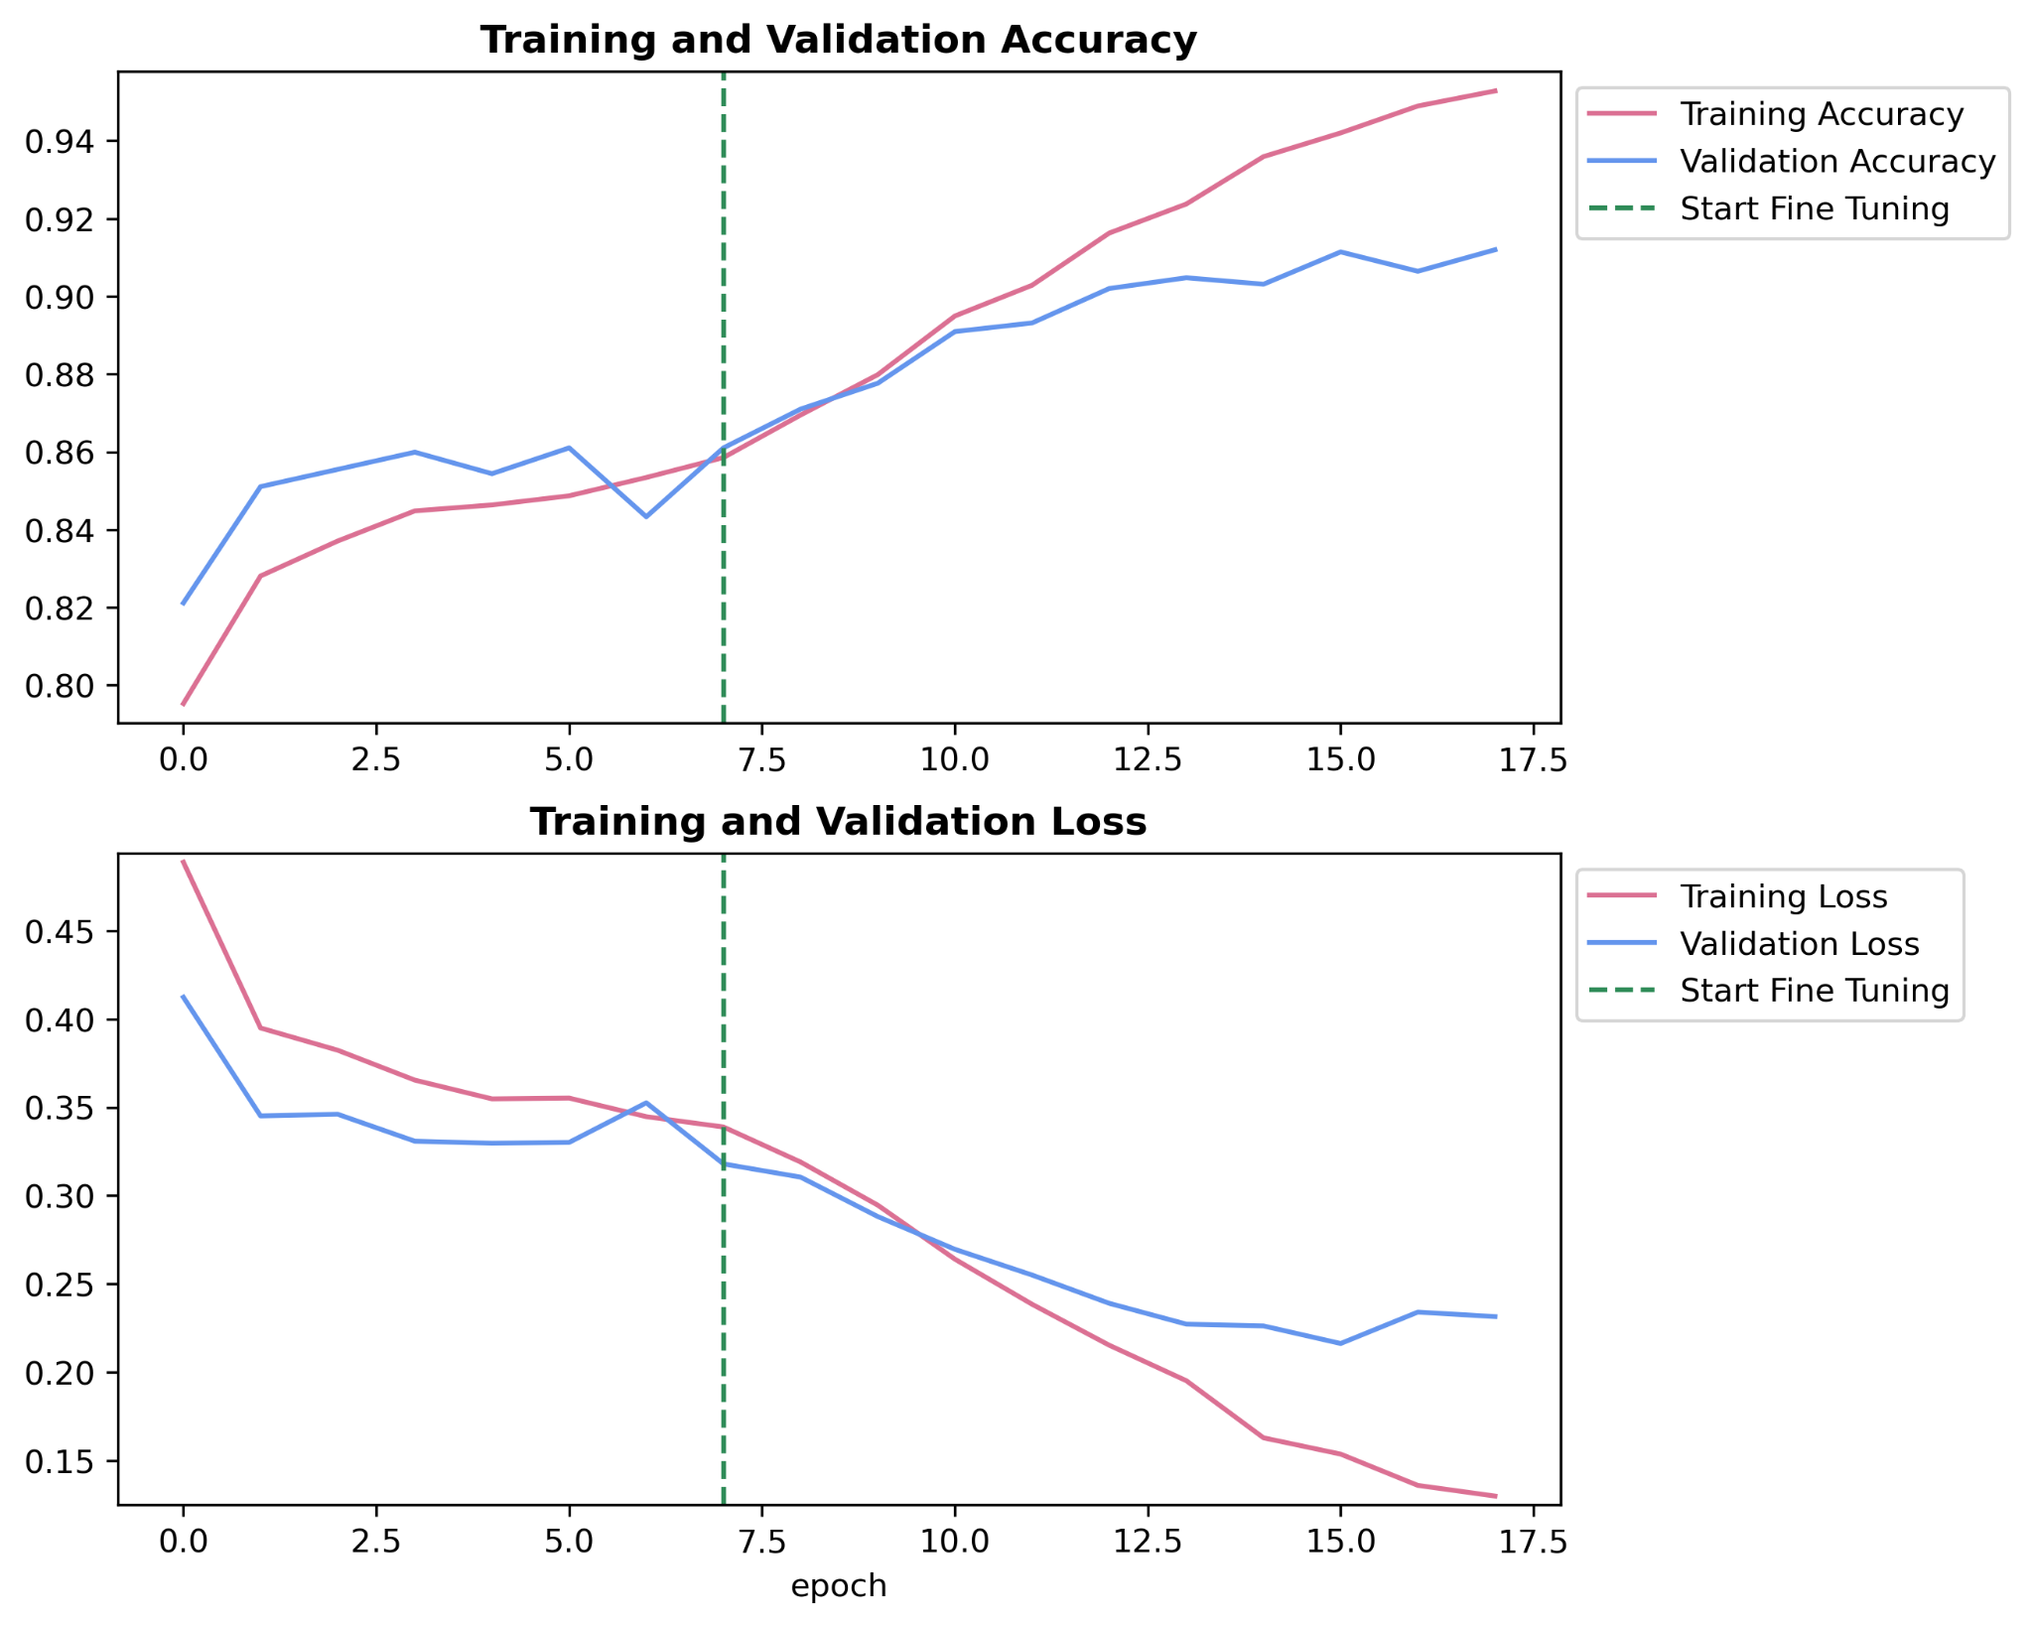
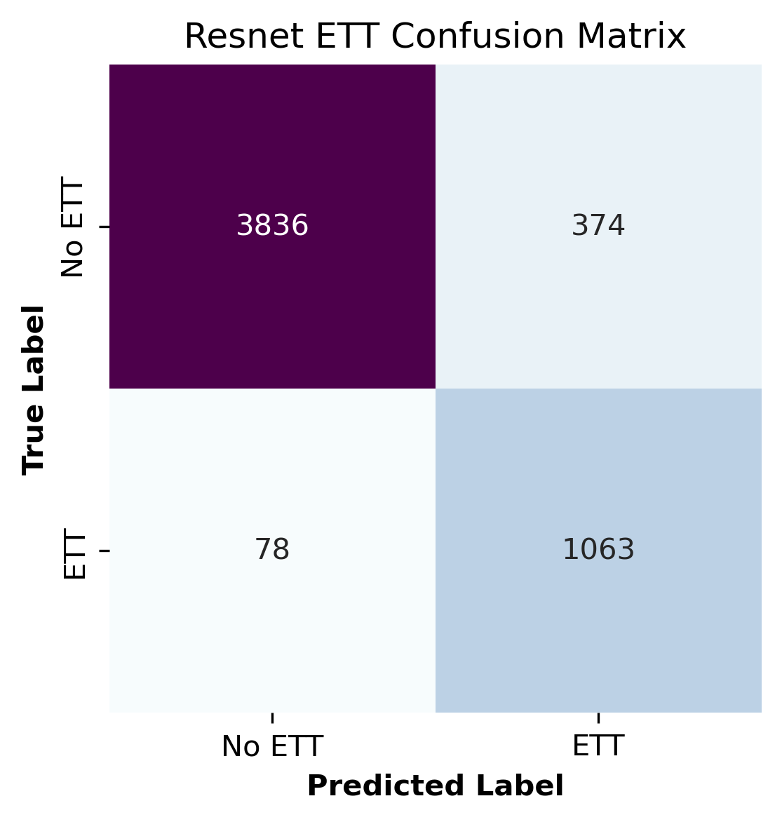
Classifying ETT Tubes

Slide 35
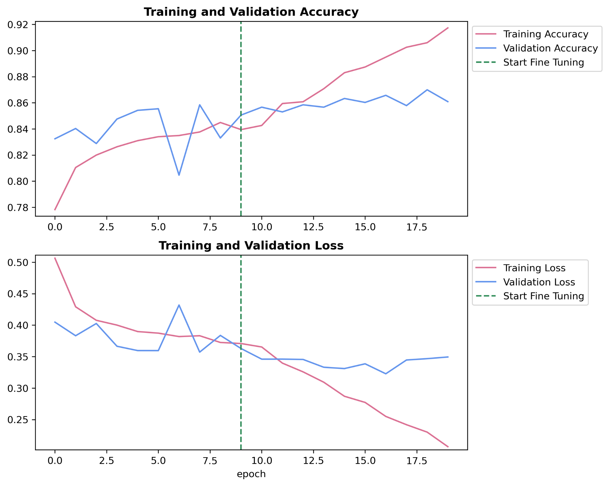
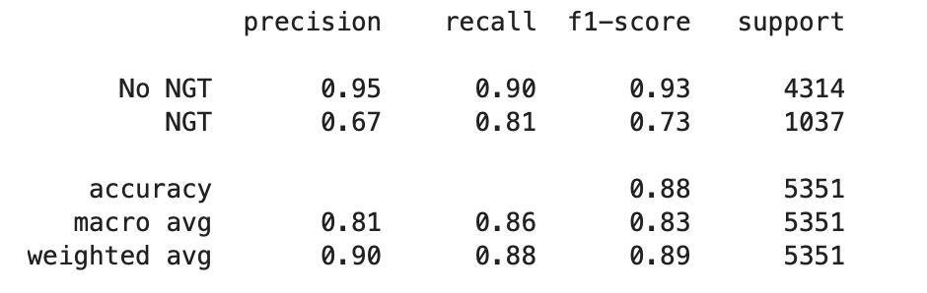
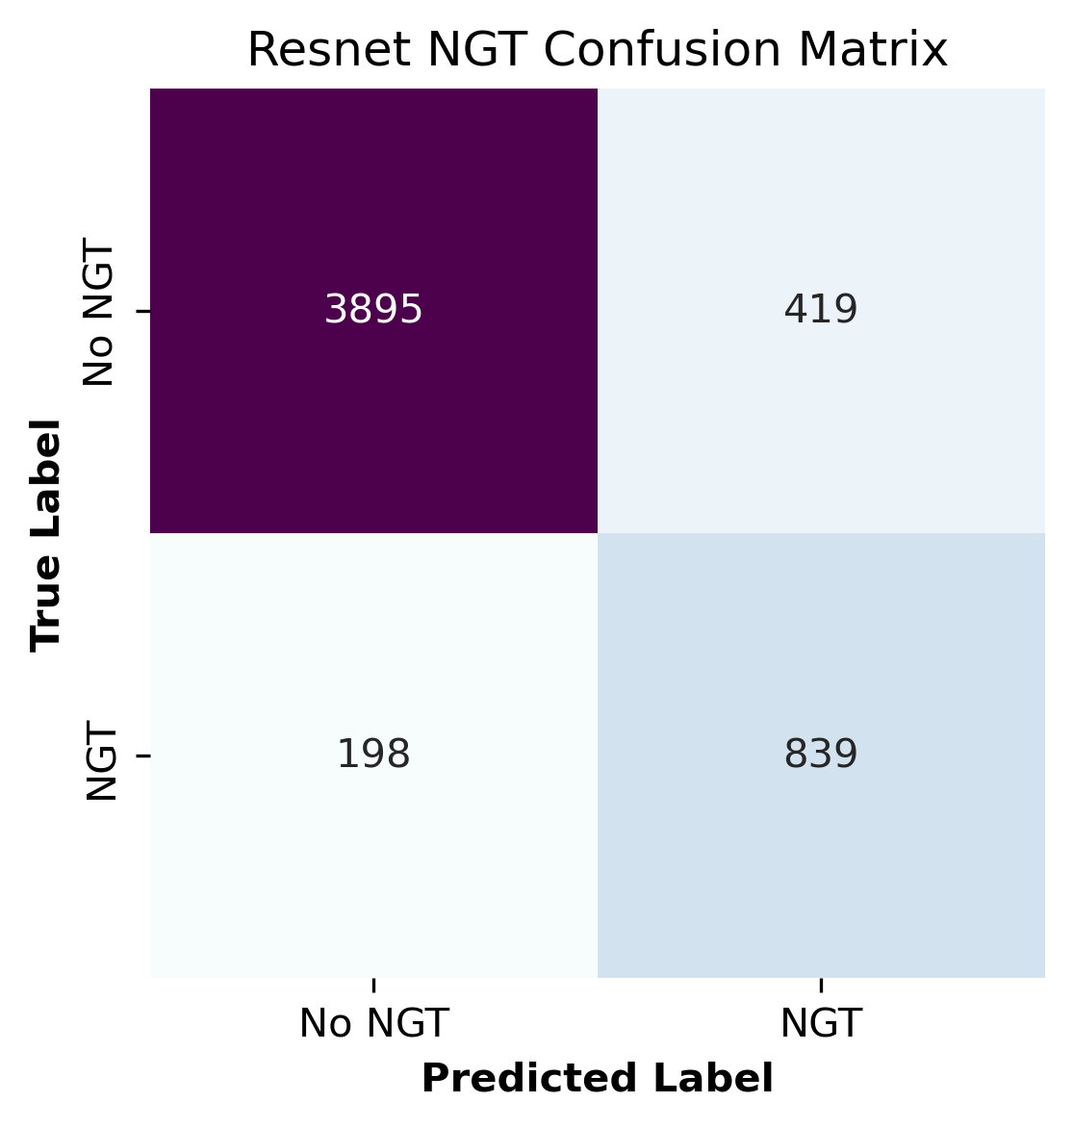
Classifying NGT Tubes

Slide 36
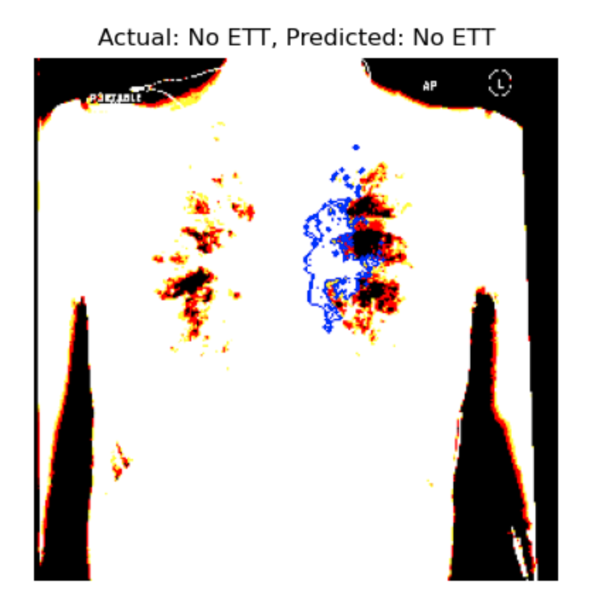
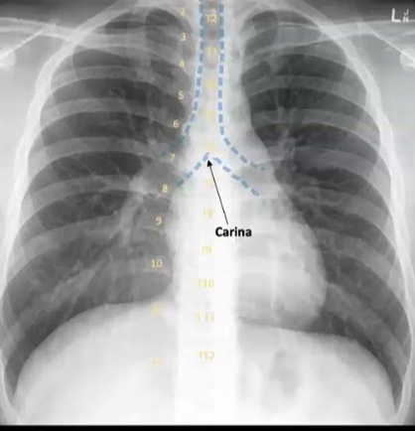
Interpreting Tube Presence Predictions Using LIME

Slide 37
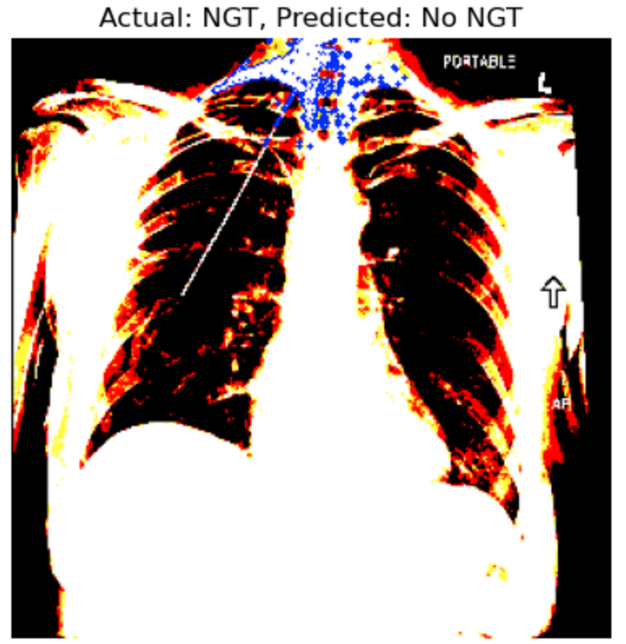
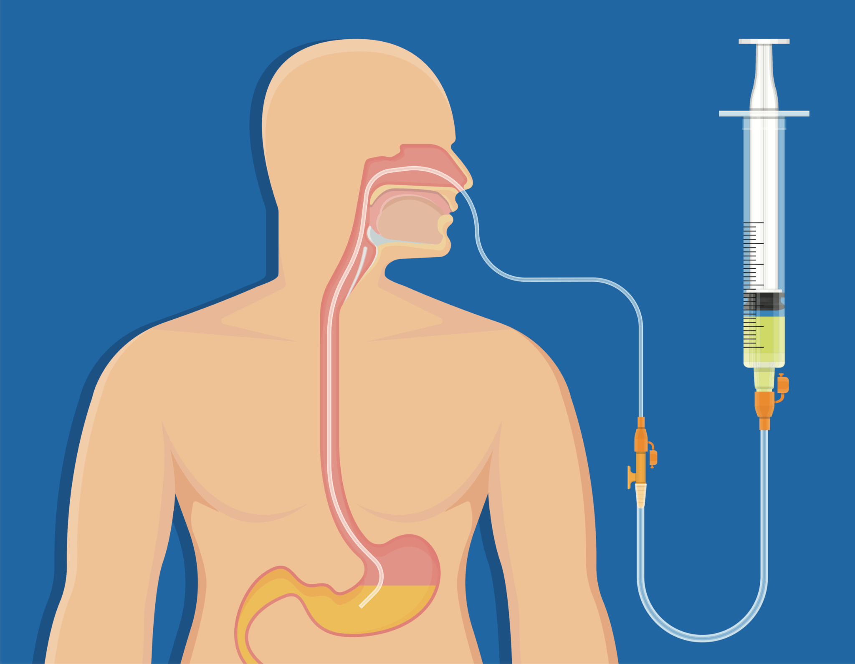
Interpreting Tube Presence Predictions Using LIME

Slide 38
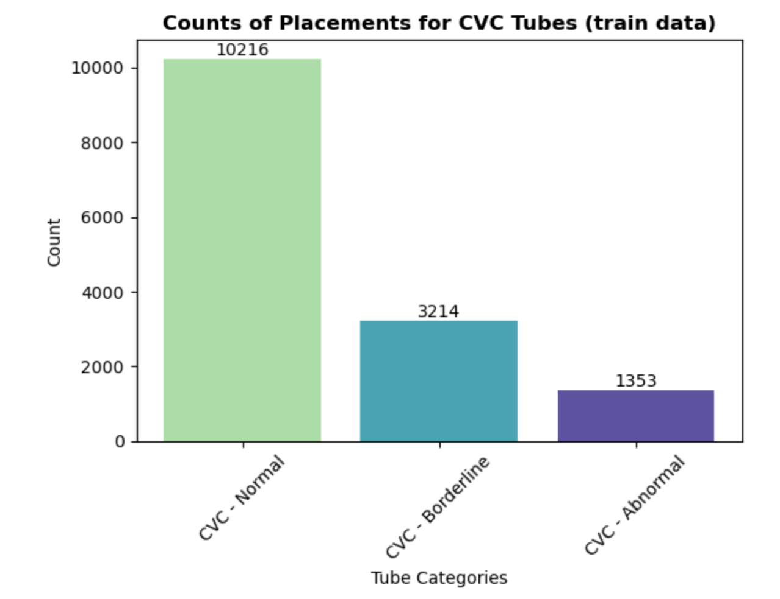
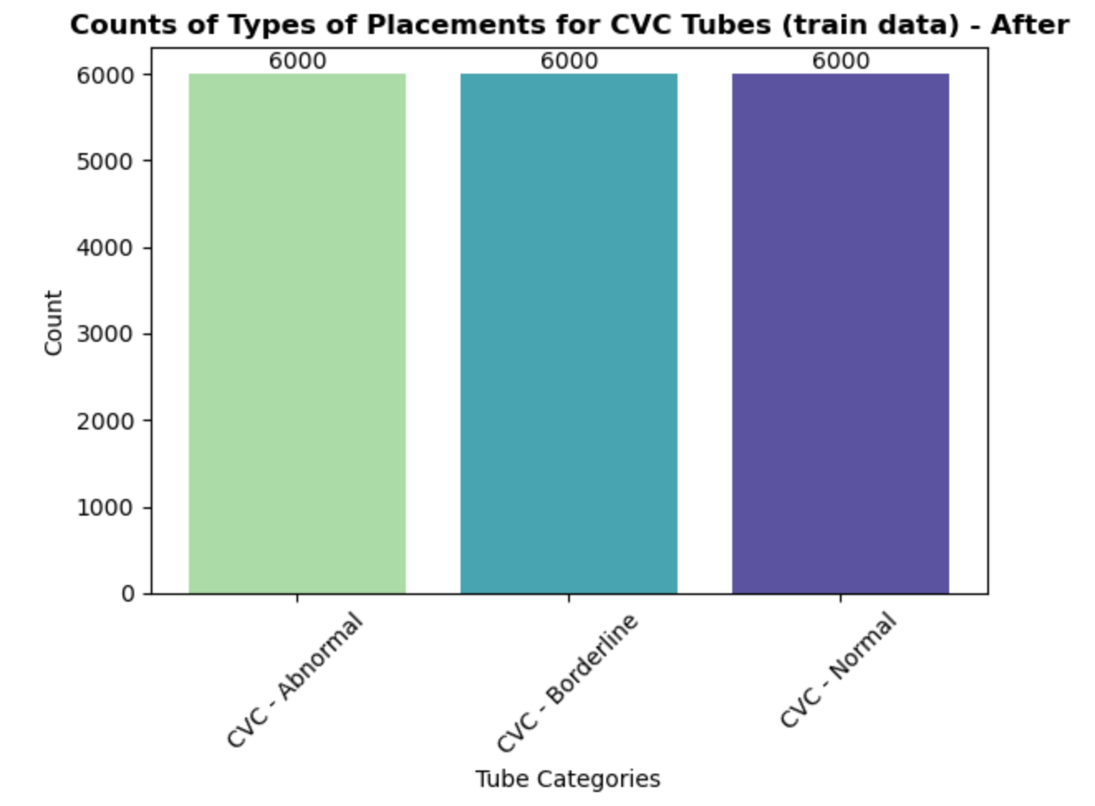

Slide 39
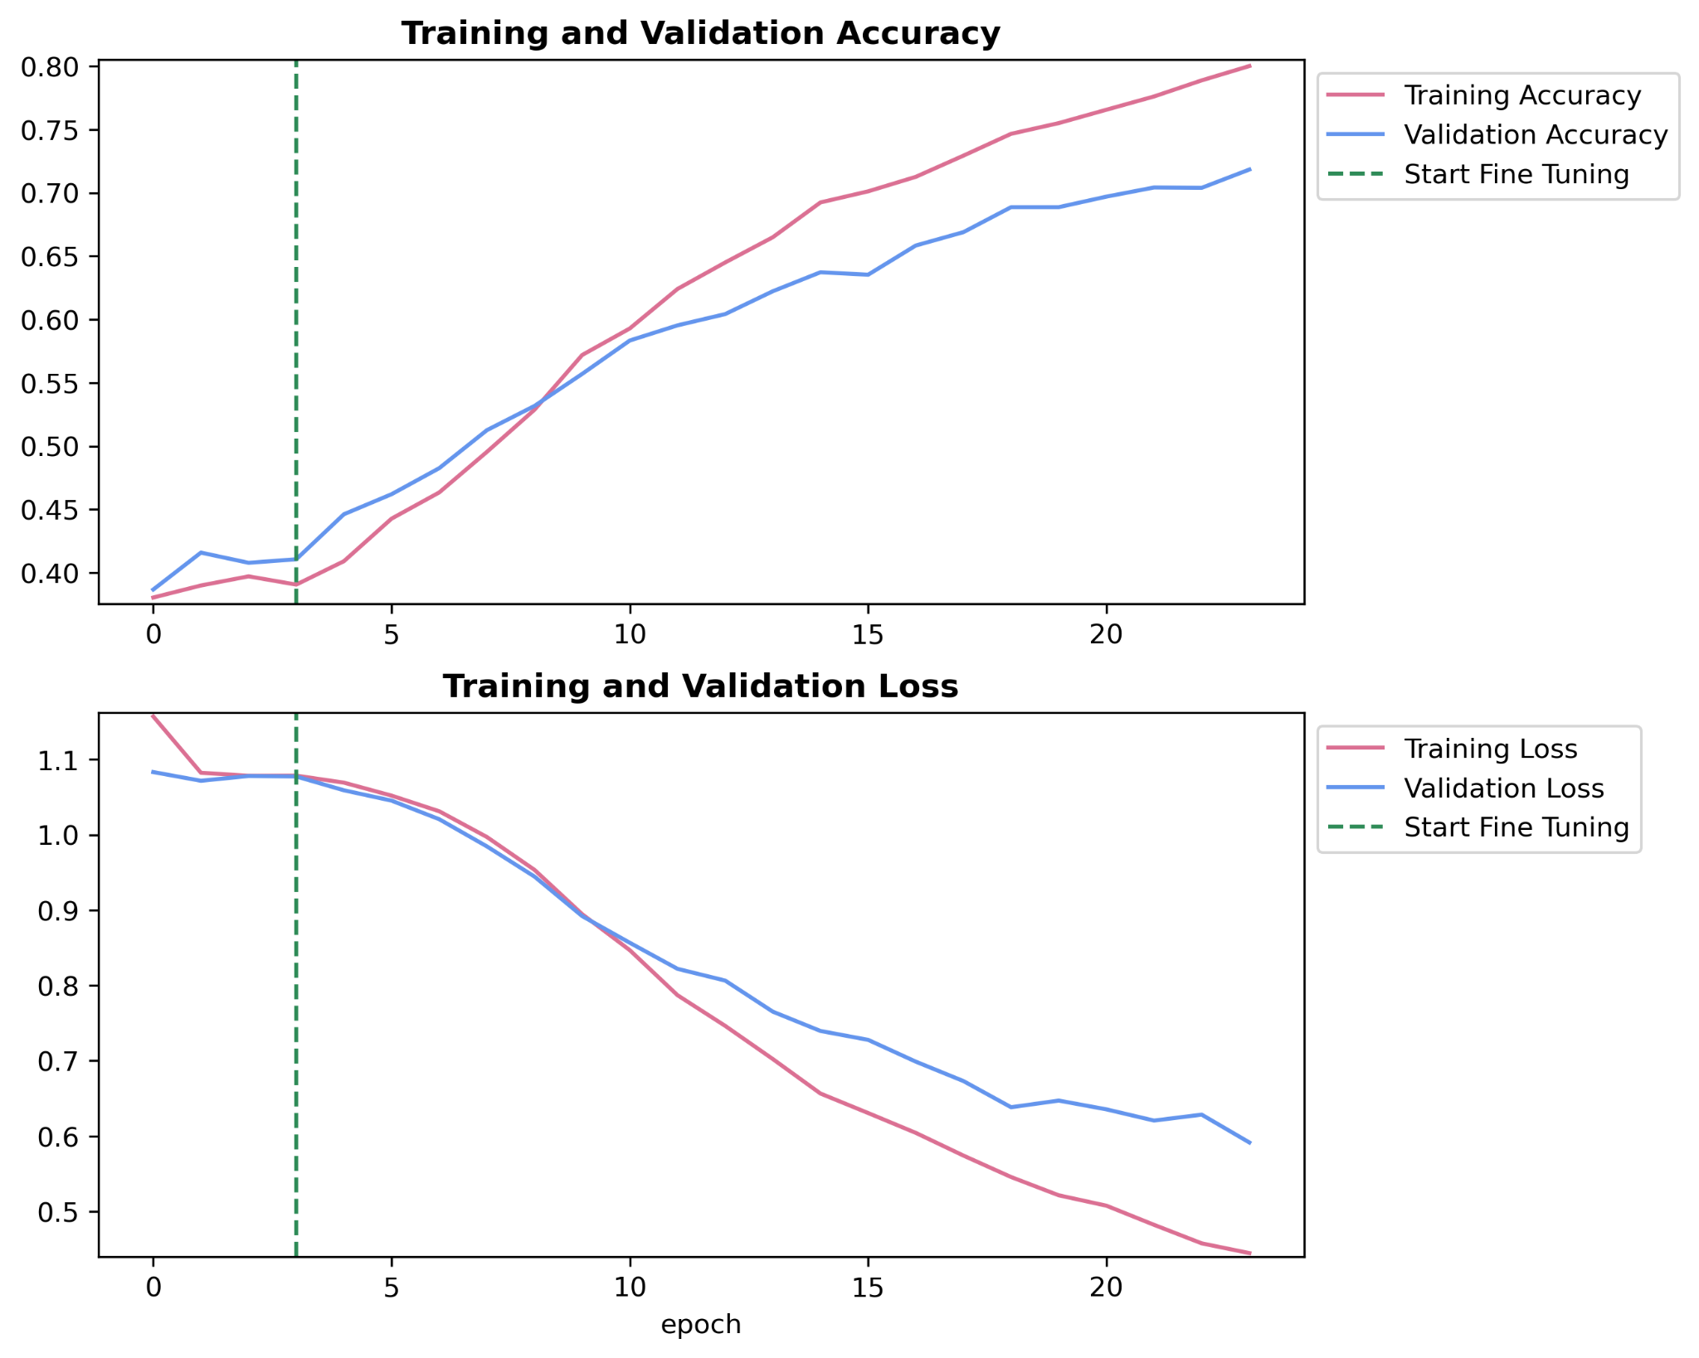
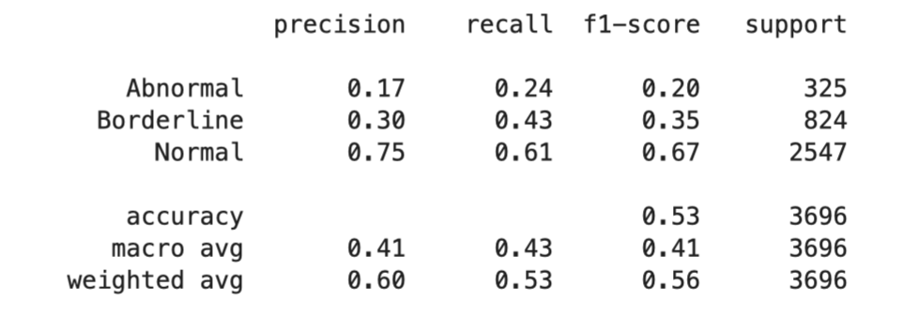

Classifying CVC Placement for Images With One Tube

Slide 40


Interpreting Placement Predictions Using LIME

Slide 41
Conclusions
Aim:
To classify the presence and proper placement of various catheters in medical images with Deep Learning Algorithm
⇒ Success!!🥹
Dataset:
30k images
Very clean - no missing values
Data Preprocessing:
Split the training, testing, validation set
Cleared rows and columns that do not help with our aim
Labeled the position of catheter

Slide 42
Conclusions
Data Analysis:
Proportion of types of tubes
Frequency of tubes in one images
Modelling:
2 purposes - predict presence of types of tubes and placement of tubes
EfficientNetB0, MobileNetV2, ResNet50
ResNet50 - provide the most balanced and best performance in general
ETT model performed the best
Identify the position of catheters with ResNet50

Slide 43
Conclusions
Challenges:
Takes forever to train a model
Overfitting on annotated images
Classes imbalance
Future:
Train the model with all-zero-data
Fine-tune the model
Implement the model with user interface and user experience

